Slide 1


DIGITAL
ENGAGEMENT
PLANNER
How to Transform Customer Struggle Into Opportunities

Slide 2
Table of Contents
Introduction: Why map customer struggle points to engagement?
Transforming 4 common struggle points into engagement opportunities
Example: Coupon code abandonment
Blank templates
3
4
6
13

Slide 3
Why map customer struggle points to engagement?
Customer struggle points are opportunities.
No matter where friction happens in the sales funnel, from awareness to service, when you successfully map common sources of friction to the right engagement opportunities, you’ll see higher conversion rates and an improved customer experience.
The struggle looks different at different points along the buying journey.
The trick is to identify the friction points and map them to effective engagements, based on your specific performance indicators and business objectives.
For some brands, success might be measured in conversion rates. For others, it’s measured in increasing margins. For both, elevating customer satisfaction is a critical KPI for competitive differentiation.

Slide 4

Transforming 4 common struggle points into engagement opportunities
Begin by leveraging your analytics resources and talking with your subject matter experts about repetitive inquiries or common roadblocks in the customer journey. Use the data to prioritize which struggle points to address first. Then, look at where customers are struggling in each buying stage – awareness, consideration, conversion,
service – and map to an appropriate engagement.
In the earlier stages, your engagement will be more subtle, while later-stage frustrations will call for a more overt response.

Slide 5




Let’s look at four common struggle points by buying stage.
1. Awareness
A common problem with visitors who are new to your site is a high bounce rate. To improve that metric, start with a subtle change in engagement, perhaps a simple greeting or some sales information.
Potential buyers will decide quickly whether your goods or services are relevant to them, so engaging them quickly with helpful content is key.
2. Consideration
Friction at the consideration stage is often related to hesitation or indecision in choosing between products. Typically, this means the buyer needs more information and will benefit from proactive outreach such as a buying guide or product comparison.
You can also take this opportunity to steer customers
in a buying direction, such as featured or higher-margin products.
3. Conversion
10% to 20% of shoppers who click the checkout icon don’t follow through with a purchase. Common struggle points here include coupon code errors and credit card validation issues.
These frustrations can cause your customers to either call you on the phone (your most expensive channel) or abandon altogether. Use your analytics to zero in on the most frequent checkout error for your vertical, and devise an engagement strategy to address it.
4. Service
Your contact center can probably tell you the top customer struggle point at the service stage. For retail, it’s often “Where my order?” For finance, it’s often “What’s my log-in?”
By offering guidance and self-service options for these common questions, you’ll improve the customer’s experience and keep them out of the contact center queue. You also free up space in that queue for those with unique use cases, improving their CSAT by shortening their wait times.

Slide 6
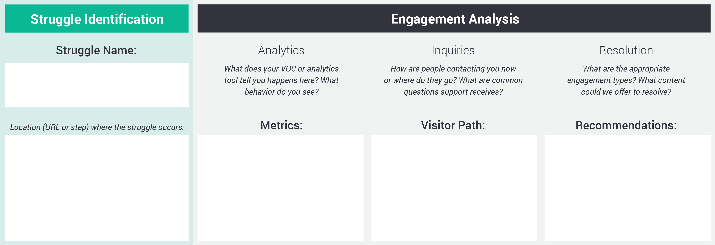
Coupon Code Abandonment Struggle Example
Here’s what the template looks like blank. Over the next few slides, we will walk you through an example demonstrating how to map struggle points to engagement opportunities for each stage of the customer journey.

Slide 7
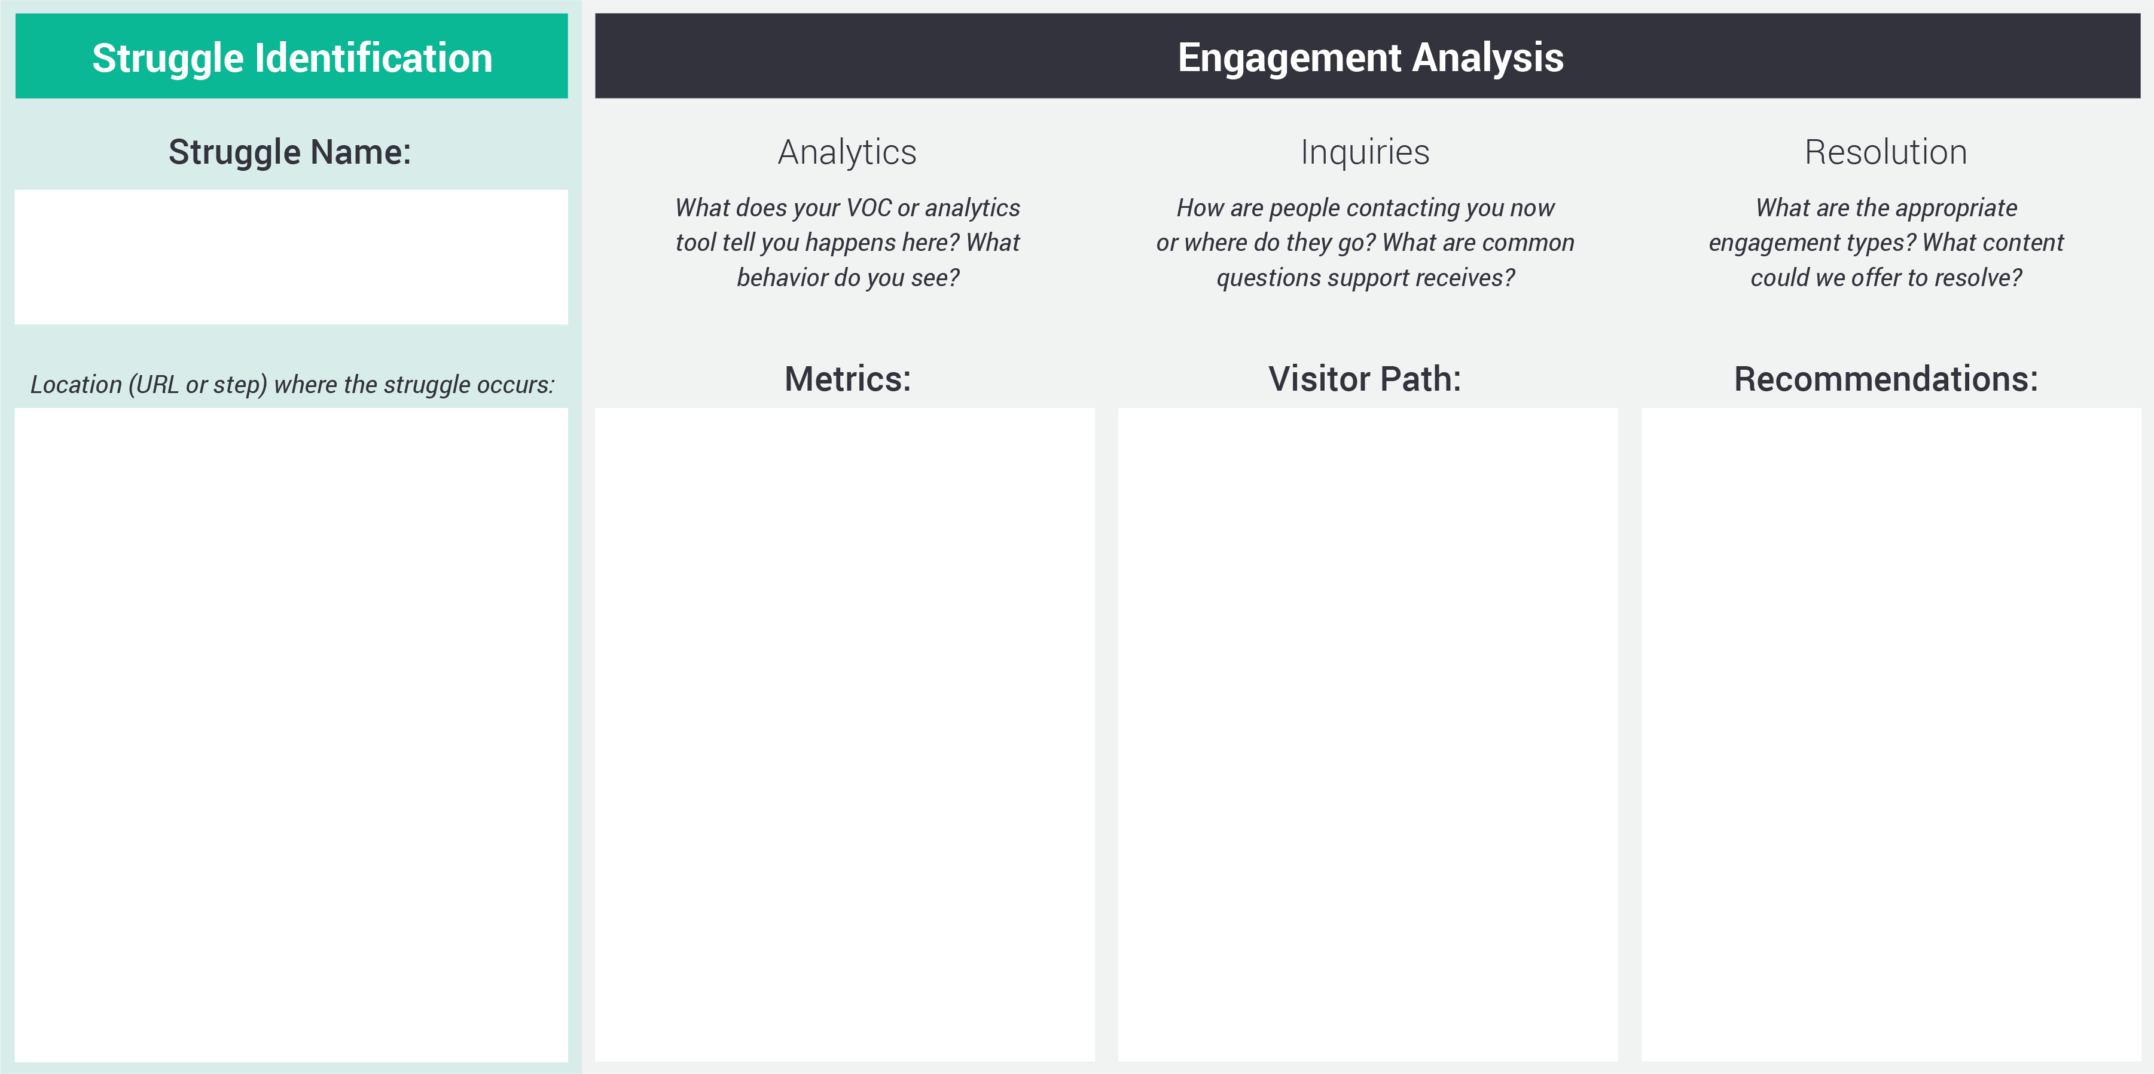
Coupon Code Abandonment Struggle Example
1
Coupon Code
Abandonment

Slide 8
Coupon Code Abandonment Struggle Example
Coupon Code
Abandonment
2
www.shop.checkout.com
Step 3 after coupon code is entered incorrectly

Slide 9
Coupon Code Abandonment Struggle Example
Coupon Code
Abandonment
3
www.shop.checkout.com
Step 3 after coupon code is entered incorrectly
70% of visitors abandon the site after their coupon code does not work
Average time on site after coupon code invalid = 1.5 mins
On average, coupon code submitted 3x after original error
Average abandoned cart value = $125

Slide 10
Coupon Code Abandonment Struggle Example
Coupon Code
Abandonment
4
www.shop.checkout.com
Step 3 after coupon code is entered incorrectly
70% of visitors abandon the site after their coupon code does not work
Average time on site after coupon code invalid = 1.5 mins
On average, coupon code submitted 3x after original error
Average abandoned cart value = $125
Majority don’t contact us (70% abandon)
Contact center statuses 5% of their calls related to coupon codes
Of those that abandon, most go back to edit card again before abandoning

Slide 11
Coupon Code Abandonment Struggle Example
Coupon Code
Abandonment
5
www.shop.checkout.com
Step 3 after coupon code is entered incorrectly
70% of visitors abandon the site after their coupon code does not work
Average time on site after coupon code invalid = 1.5 mins
On average, coupon code submitted 3x after original error
Average abandoned cart value = $125
Majority don’t contact us (70% abandon)
Contact center statuses 5% of their calls related to coupon codes
Of those that abandon, most go back to edit card again before abandoning
Segment audience with coupon code error based on cart value
Offer those with over $200 in their cart content with working coupon code
For any that go back to edit cart and then abandon, send follow up email

Slide 12

Your Turn!
Here are 3 blank engagement opportunity templates
to get you started. Need more? Simply right click
(or ctrl click) on a slide to the left and select “Duplicate.”
Need more expert tips on engagement mapping?
Contact us!
www.gomoxie.com
info@gomoxie.com
+1.800.474.1149

